Slide 1
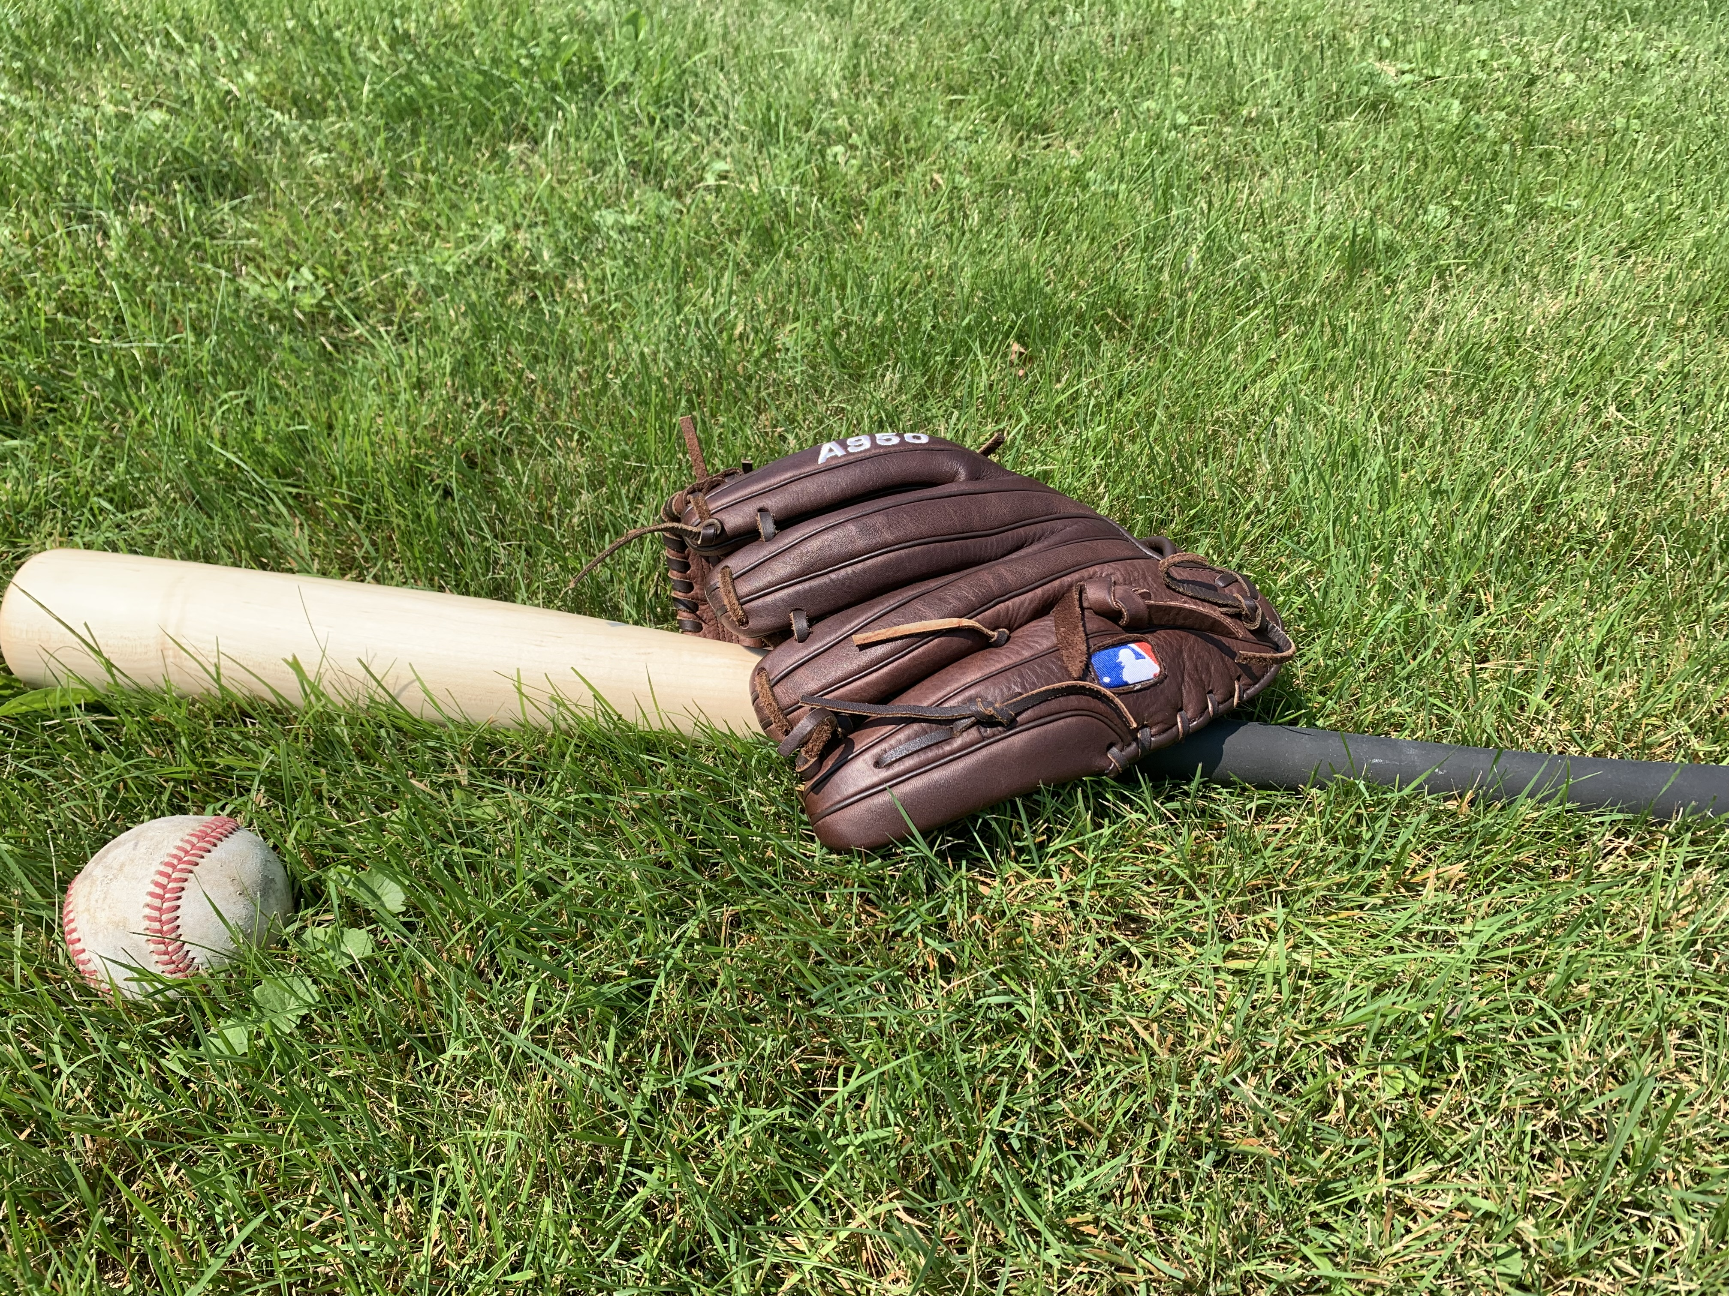
The 2023 Major League Baseball Rule Changes
Andrew Evan

Slide 2
Three Dramatic Rule Changes
Larger Bases
Pitch Clock
Defensive Shift Limitations

Slide 3
Larger Bases
Goal
Improve Player Safety
Increase Excitement
Base Size Increased from 15 in² to 18 in²
Distance Between Bases Shortened
Distance between bases reduced by 4 ½ inches (89.625 ft)
Distance to/from Home reduced by 3 inches (89.75 ft)
Impact on Game
Stolen Bases per Game
Stolen Base Percentage

Slide 4
Pitch Timer
Goal
Quicker Pace of Play
Rule Changes
Pitchers have 15 seconds per Pitch, or 20 seconds with Runners on Base
Batter Alert at 8 seconds
Disengagements
Allowed 2 per At-Bat
Resets if a Runner Advances
Unsuccessful Third Attempt Advances Runner
Mount Visit Limitations
Impact on Game
Length of Games
Fan Attendance

Slide 5
Defensive Shift Limitations
Goal
Increase Batting Average on Balls in Play
Allow Infielders to Showcase their Abilities
Rule Changes
Four infielders must be on the boundary of the infield
Two infielders completely on either side of second base
Impact on Game
Fielding Percentage
Batting Average on Balls in Play (BABIP)

Slide 6
Data
baseball-reference.com
Visualizations and Calculations Completed in Rstudio and Excel
Other Sources
MLB Website
Society for American Baseball Research (SABR)
Baseball Savant
Analyzing Baseball Data with R (Second Addition)
Max Marchi, Jim Albert, and Benjamin S. Bauer
The New Ballgame: The Not-So-Hidden Forces Shaping Modern Baseball
Russell A. Carleton

Slide 7
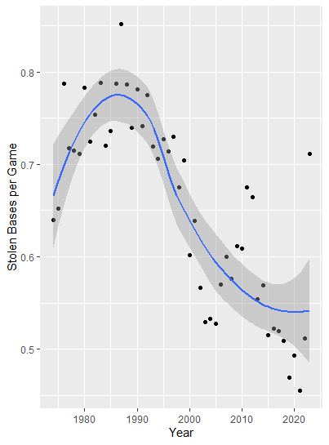
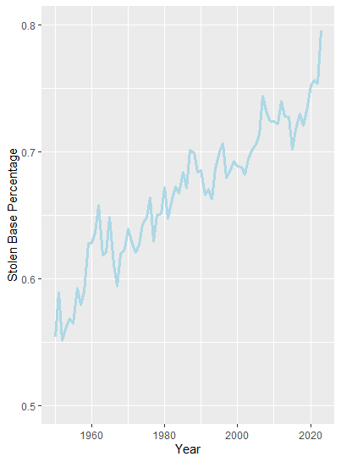
Stolen Bases

Slide 8
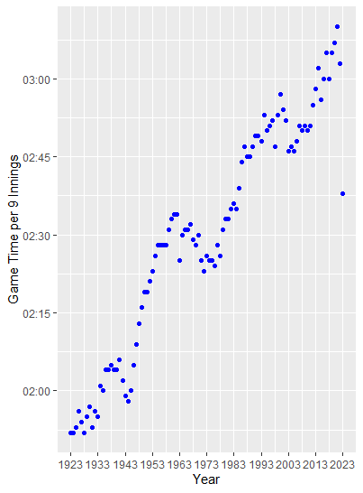
Game Length

Slide 9
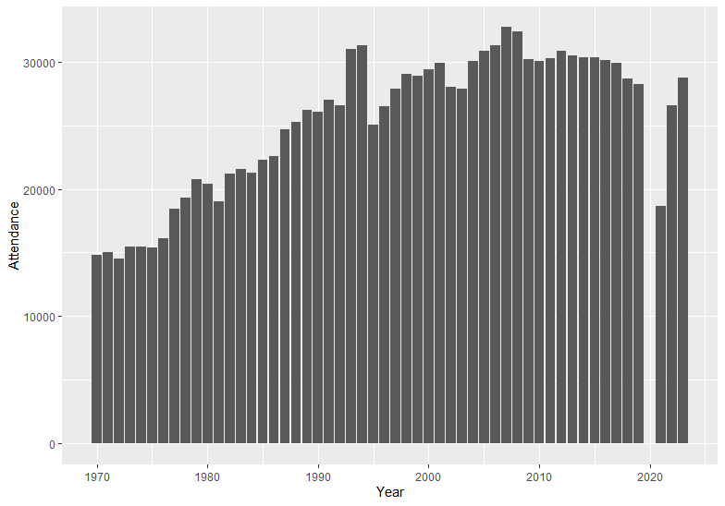
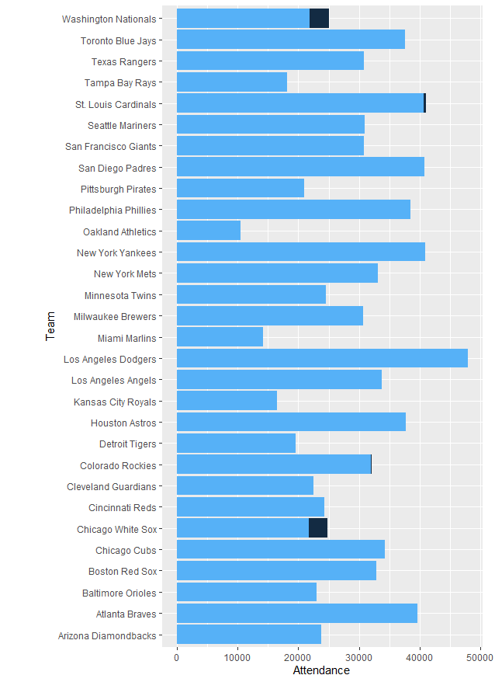
Fan Attendance

Slide 10
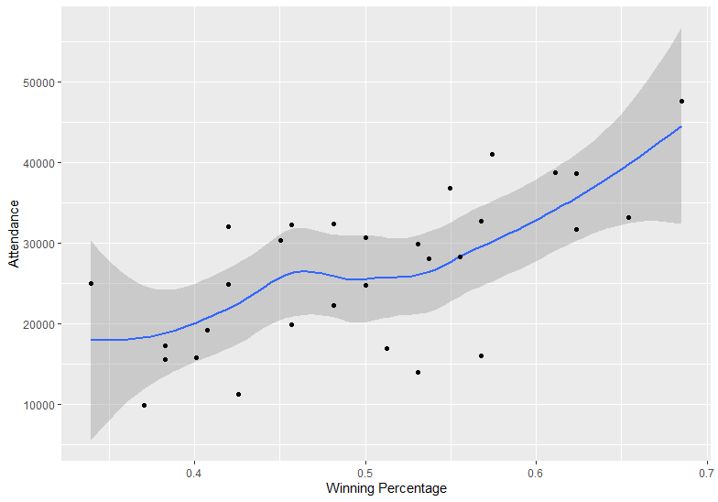
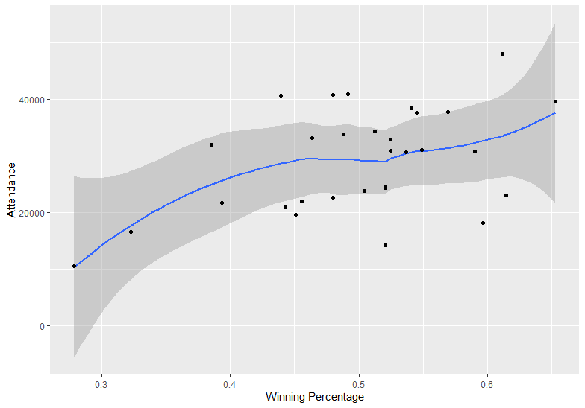
Fan Attendance
2022
2023

Slide 11
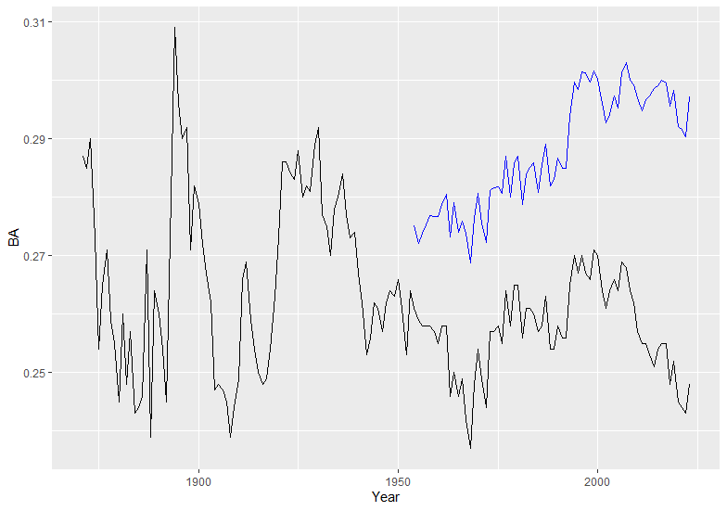
Batting Average Balls in Play (BABIP)
H – HR
AB – HR – SO + SF

Slide 12
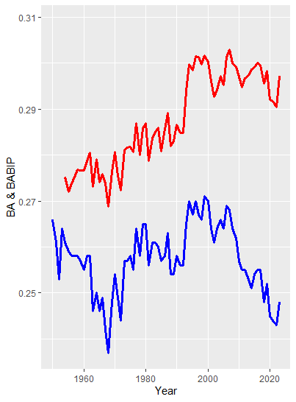
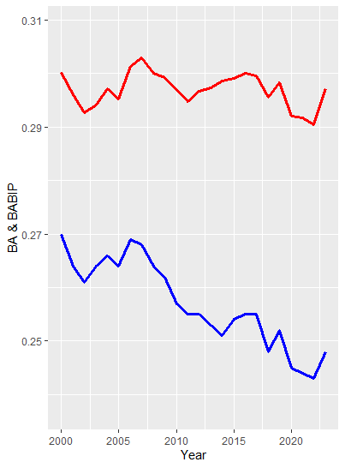
BABIP

Slide 13
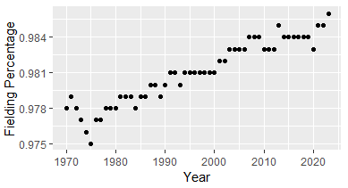
Fielding

Slide 14
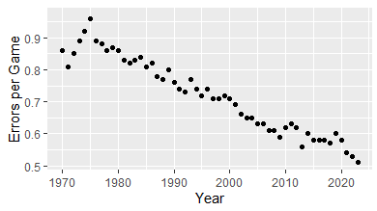
Fielding

Slide 15
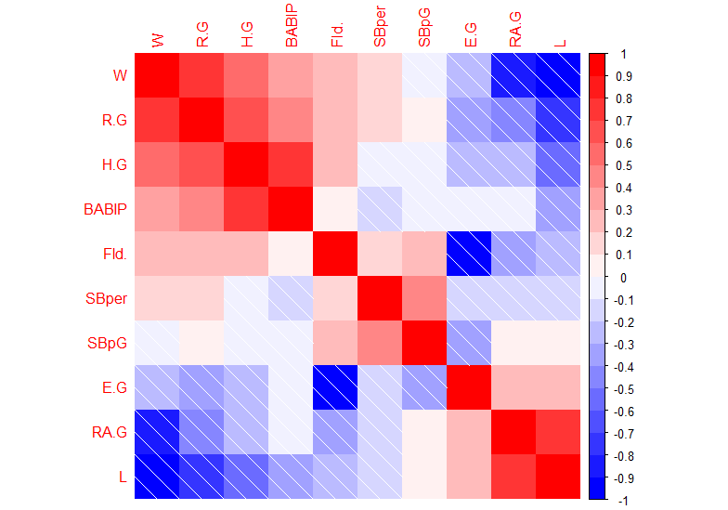
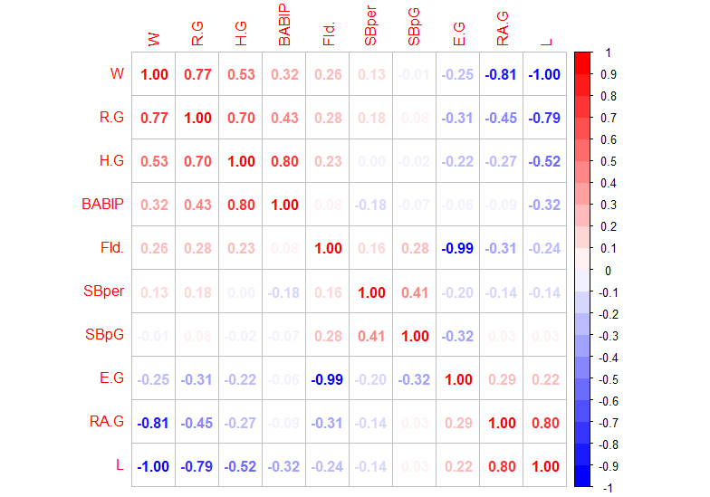
Rule Changes Impact

Slide 16
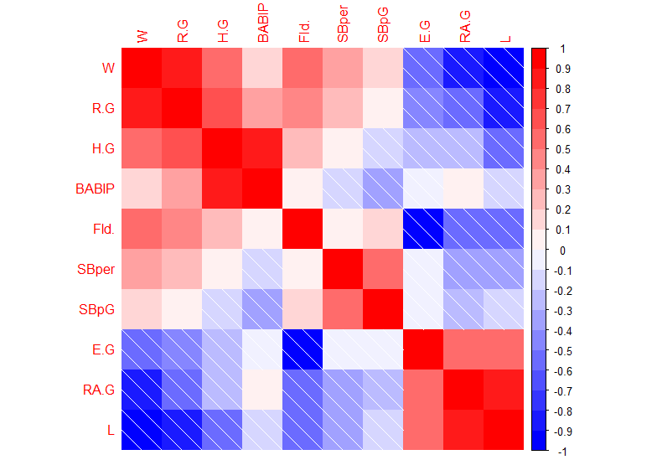
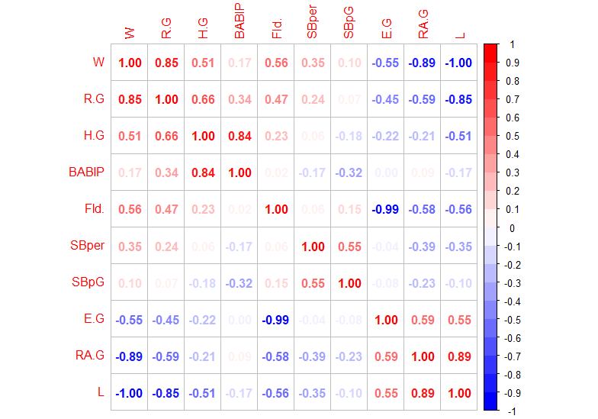
2023
2022

Slide 17
2023
2022

Slide 18
2023
2022

Slide 19
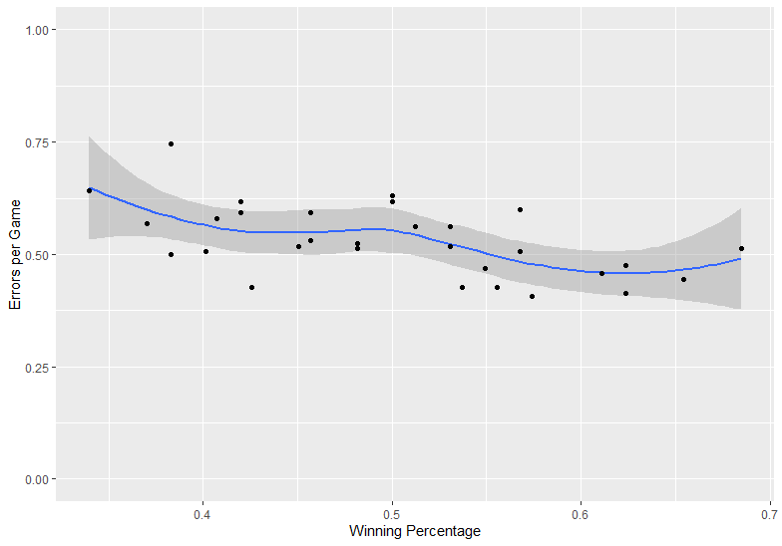
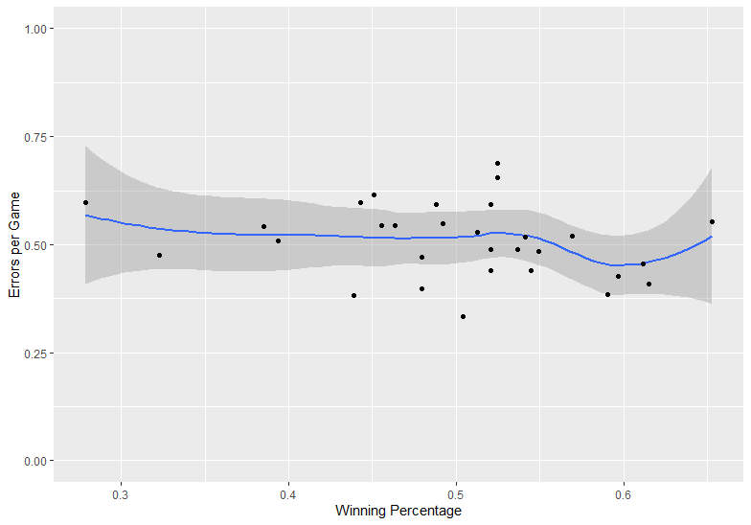
Analysis Fielding
2022
2023

Slide 20
2023
2022

Slide 21
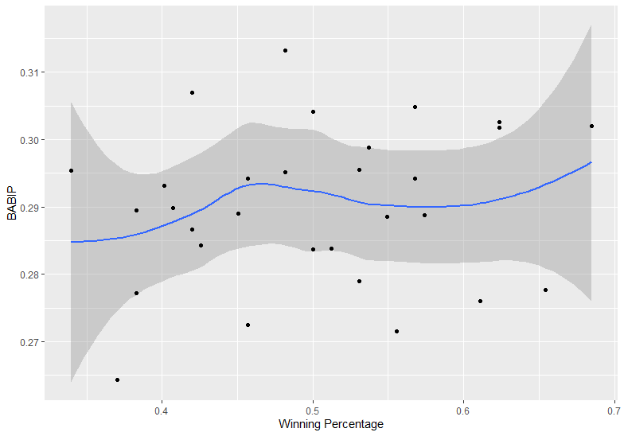
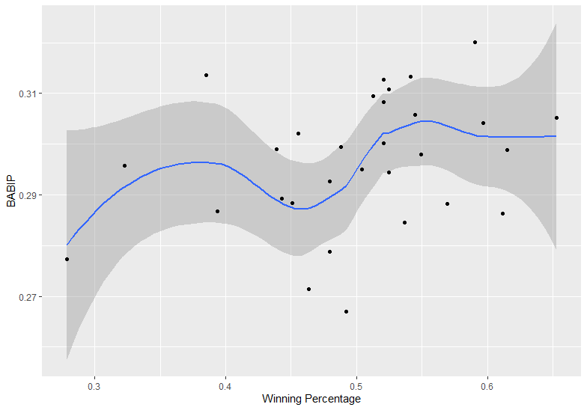
Analysis BABIP
2022
2023

Slide 22
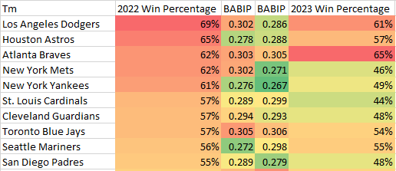
Analysis Winners and Losers

Slide 23
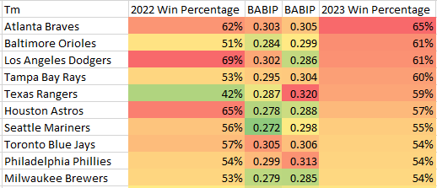
Analysis Winners and Losers

Slide 24
2023
2022

Slide 25
2023
2022

Slide 26
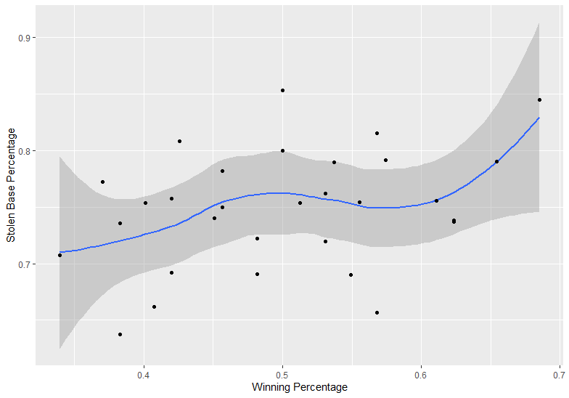
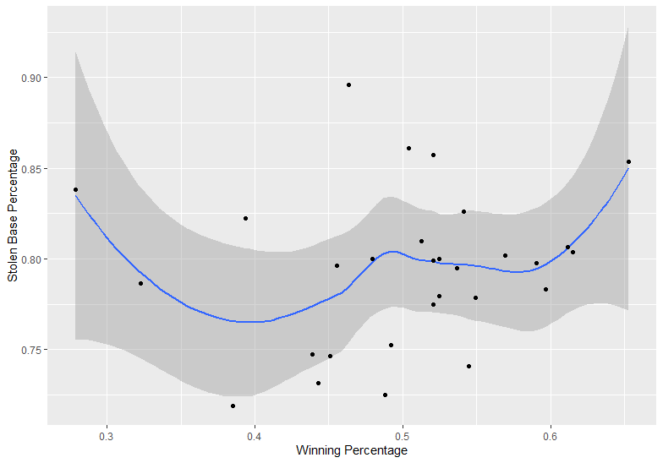
Analysis Stolen Bases
2022
2023

Slide 27
Conclusion

